Slide 1
Partial Order and Lattices
Lecture 8
Discrete Mathematical Structures

Slide 2
At the Last Classes
Part I: Basics of Functions
  Function as a class of special relations
  Types of functions
  Permutation: bijection on one set
Part II: Functions and Computer Science
  Commonly used function in computer applications
  Growth of functions

Slide 3
Partial Order and Lattices
Part I: Partial Order
  Order relations and Hasse Diagrams
  Extremal elements in partially ordered sets
Part II: Lattices
  Lattices as a mathematical structure
  Isomorphic lattices
  Properties of lattices

Slide 4
Partial Order
Reflexive, antisymmetric and transitive
  Generalization of “less than or equal to”
Denotation: ≼
Example 1: set containment
  Note: not any two of sets are “comparable”
Example 2: divisibility on Z⁺

Slide 5
Partially Ordered Set
a partially ordered set(poset) is a set with a partial order defined on it.
Denotation: (A, ≼)
Examples
  (Z, ≤) or (Z, ≥)
  (Z⁺, | )
  (2^{A}, ⊆)

Slide 6
Product Partial Order
Given two posets, (A, ≼_{A}) and (B, ≼_{B}), we can define a new partial order ≼ on A×B:
(a,b)≼(a’,b’) iff. a≼_{A}a’ in A and b≼_{B}b’ in B
  It is easy to prove that (A×B, ≼) is a poset
Lexicographic order, as simplified:
  Given a partial order on a alphabet a, then ≼ is a simplified “dictionary” order:
  (a,b)≼(a’,b’) iff. a≼a’ and a≠a’ or a=a’ and b≼b’
Denoted as a≺a’

Slide 7
Hasse Diagrams
Partial order can be represented by
common relation diagram
The special properties of partial order can be used to simplifying the diagram
  Reflexivity: ring everywhere, so no need
  antisymmetric: no cycle, location dependent
  Transitivity: there is a path, there is a edge

Slide 8
Divisability on {1,2,3,...12}
9
12
8
10
11
7
6
4
5
3
2
1

Slide 9
Containment on ρ({a,b,c})
{a,b,c}
{a,b}
{a,c}
{b,c}
{a}
{b}
{c}
φ

Slide 10
Isomophism
Let (A,≼) and (A’, ≼’) be posets and let f:A→A’ be a one-to-one correspondence between A and A’. The function f is called an isomophism from (A,≼) to (A’, ≼’) if for any a and b in A, a≼b iff. f(a)≼’f(b). The two posets are called isomophic posets.
Example: Z⁺ and the set of positive even number are isomophic under “≤”
Principle of Correspondence.

Slide 11
Maximal and Minimal Elements
an element a∈A is called a maximal element of a if there is no element c in a such that a≺c.
an element b∈A is called a minimal element of a if there is no element c in a such that c≺b.

Slide 12
Existence of Maximal/Minimal Elements
Given a poset (a,⋞), if a is finite, then there is at least one maximal element and at least one minimal element.
  Proof:
  Let a be any element of a, If a is not maximal, there must be some a₁, such that a⋞a₁. If a₁ is not maximal either, there must be some a₂, such that a₁⋞a₂. Since a is finite, we can’t continue this procedure indefinitely, and find some a_{k}, which is maximal.
  Same for the minimal element.

Slide 13
Examples of Maximal/Minimal Elements
Divisibility on {2,3,4, 5, 6,8,12,18}
  Maximal elements: 5, 8, 12, 18
  Minimal elements: 2, 3, 5
8
12
18
Maximal
4
6
Minimal
Note: 5 is maximal and minimal
2
3
5

Slide 14
Greatest and Least Elements
an element a∈A is called a greatest element of a if x≼a for all a∈a.
an element a∈A is called a least element of a if a≼x for all a∈a.

Slide 15
Examples of Greatest and Least Elements
Containment on ρ({a,b,c})
  Greatest element: {a,b,c}
  Least element: φ
Divisibility on {2,3,4, 6,12}
  Greatest element: 12
  Least element: none (Note: there are two minimal elements: 2 and 3)

Slide 16
Uniqueness of Largest Element
a poset has at most one greatest element.
  Proof
  Suppose that there are two greatest elements, a and b. By the definition of the greatest elements, we have a≼b, and b≼a. So, a=b, by the antisymmetry property
It is same for the least element.

Slide 17
Bounds of Subsets of Poset
Given a poset A and its subset B, an element a∈A is called an upper bound of B if b≼a for all b∈B.
For a given subset B, upper bound may not exist. On the other hand, there may be more than one upper bound. The least element(if existing) of the poset consisting of all upper bounds of B is called the least upper bound(LUB)
Lower Bound and Greatest Lower Bound can be defined similarily.

Slide 18
Example of Bounds
h
Upper bounds
h
Upper bounds
f
g
f
g
d
e
d
e
GLB
c
LUB
c
B₂
a
b
a
b
Lower bounds
B₁

Slide 19
Linear Ordering and Well-Ordering
(A,≼) is a poset.
  Linear-ordering – any two element of A are comparable.
  Well-ordering - every nonempty subset of A has a least element
  If every nonempty subset of A has a least element, then any two elements of A are comparable.
  If any two elements of A are comparable, can it be implied that every nonempty subset of A has a least element?
  No, for infinite A.

Slide 20


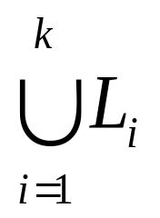
Chain and Anti-chain
An antichain with elements as many as possible, including k elements
For i=1,2,…,k, starting from a_{i}, constructing a chain L_{i}, including as many elements as possible. L_{i} doesn’t contain elements in L₁,…, L_{i-1} .
….
….
a₁
a₂
a_{k}
a_{i}
must contain all elements in the poset. Why?

Slide 21
Order in Disorder
In any permutation of natural numbers 1,2,3,…,n²+1, there must be a strictly increasing or decreasing sequence with length not less than n+1.
  Proof:
  Given a permutation, labeling each number using a pair (p,q), where p is the length of the largest increasing sequence ending at the number, and q is the length of the largest decreasing sequence ending at the number. Note, each number has a unique label (Why?). If p and q are both not larger than n, there are only n² possible label value.

Slide 22
Order in Disorder: PO Model
In any permutation of natural numbers 1,2,3,…,n²+1, there must be a strictly increasing or decreasing sequence with length not less than n+1.
The model of partial order:
  Set: A={ <i,v_{i}> |i=1,2,…,n²+1, each v_{i} has an unique value in 1,2,…,n²+1}
  Two partial orderings
    R₁: <i,v_{i}>R₁<j,v_{j}> iff. i<j and v_{i}<v_{j}
    R₂: <i,v_{i}>R₂<j,v_{j}> iff. i<j and v_{i}>v_{j}
Problem: Prove that there must a subset of A with no less than n+1 elements, which is a chain of R₁ or R₂.
  Note: a chain of R₁ is a antichain of R₂, and vice versa.

Slide 23
Lattices
Definition
(L,≼) is called a lattice if
  (L,≼) is a poset
  For any x,y∈L, {x,y} has a LUB, which is denoted as x∨y (join)
  For any x,y∈L, {x,y} has a GLB, which is denoted as x∧y (meet)

Slide 24
Examples of Lattice
({1,2,3,4,6,8,12,16,24,48},|)
  x⋀y=gcd(x,y), x⋁y=lcm(x,y)
(ρ(B), ⊆)
  x⋀y=x⋂y, x⋁y=x⋃y
(Z, ≤)
  x⋀y=min{x,y}, x⋁y=max{x,y}

Slide 25
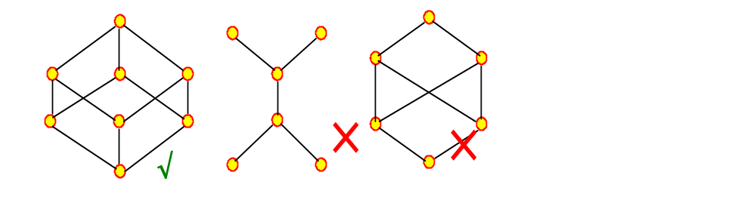
Lattice and Hasse Diagram
The posets represented by the two hasse diagram on the right are not lattices.

Slide 26
Basic Formula about Lattices
By the definitions of LUB and GLB, it is easy to prove that:
  a≼a⋁b, b≼a⋁b
  If a≼c, b≼c, then a⋁b≼c
  a⋀b≼a, a⋀b≼b
  If c≼a, c≼b, then c≼a⋀b

Slide 27
Algebraic Properties of Lattice
Idempotent properties
  a∨a = a∧a =a
Commutative properties
  a∨b=b∨a; a∧b=b∧a
Associative properties
  a∨(b∨c)=(a∨b)∨c; a∧(b∧c)=(a∧b)∧c
Absorption properties
  a∨(a∧b)=a; a∧(a∨b)=a

Slide 28
More Properties of Lattices
Let L be a lattice，∀a,b,c,d∈L, If a≼b, c≼d, then a⋀c≼b⋀d, a⋁c≼b⋁d
  a⋀c≼a≼b, a⋀c≼c≼d, then a⋀c is one lower bound of {b,d}，∴a⋀c≼b⋀d;
  a≼b≼b⋁d, c≼d≼b⋁d, so, b⋁d is one of the upper bound of {a,c}, ∴a⋁c≼b⋁d

Slide 29
More Properties of Lattice
Distributive Inequality
∀a,b,c∈L, a⋁(b⋀c)≼(a⋁b)⋀(a⋁c)
  Since a≼a and b⋀c≼b, we have a⋁(b⋀c)≼ (a⋁b), on the other hand, since a≼a and b⋀c≼c, we have a⋁(b⋀c)≼(a⋁c), i.e. a⋁(b⋀c) is a lower bound of {(a⋁b), (a⋁c)}
  ∴ a⋁(b⋀c)≼(a⋁b)⋀(a⋁c)
  Similarily, it is easy to prove that:
  (a⋀b)⋁(a⋀c)≼a⋀(b⋁c)

Slide 30

Sublattice
Let (L,⋀,⋁) is a lattice, S is a nonempty subset of L. If S is close under the operations ⋀ and ⋁, then S is a sublattice of L.
Example:
  Let S₁={a,b,d,h}; S₂={a,b,d,f}
  Then S₂ is a sublattice,
  but S₁ is not (b⋀d∉S₁)

Slide 31
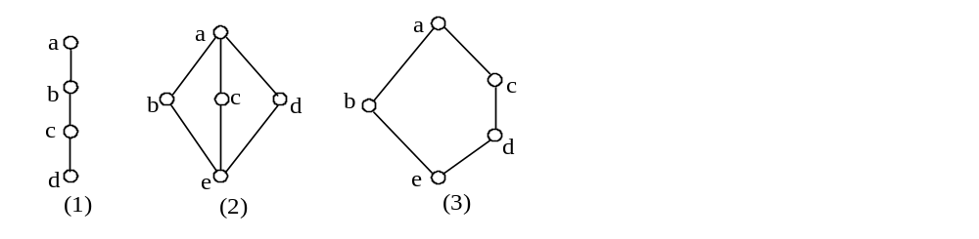
Several Special Lattice
(1) Chain
(2) Diamond lattice
  Note: b⋁(c⋀a)=(b⋁c)⋀a=a
(3) Pentagon lattice
  Note: c⋁(b⋀d)=c⋁e=c ≠ (c⋁b)⋀d=a⋀d=d

Slide 32
Distributive Lattice
Definition: L is a lattice, if for all a,b,c∈L, a⋀(b⋁c)=(a⋀b)⋁(a⋀c), then L is called a distributive lattice.
  Note: a⋀(b⋁c)=(a⋀b)⋁(a⋀c) iff. a⋁(b⋀c)=(a⋁b)⋀(a⋁c)
  Diamond(2) and pentagon(3) are not distributive lattices.
    In (2)，b⋀(c⋁d)=b,
    but (b⋀c)⋁(b⋀d)=e
    In (3) d⋁(b⋀c)=d,
    but (d⋁b)⋀(d⋁c)=c

Slide 33
Characteristics of Distributive Lattices
Lattice L is a distributive lattice if and only if it does not contain sublattice isomophic to diamond lattice or pentagon lattice.

Slide 34
Bounded Lattice
A lattice L is bounded if L has both a greatest element I and a least element 0.
Finite lattice is bounded lattice
  I is a₁⋁a₂⋁…⋁a_{n}
  0 is a₁⋀a₂⋀…⋀a_{n}。
If L is a bounded lattice, then for all x in L
  I⋀x=x; I⋁x=I
  0⋀x=0; 0⋁x=x

Slide 35
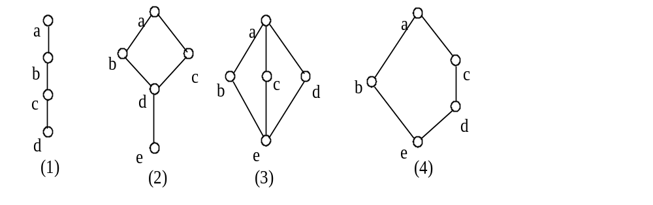
Complement
Let L is a bounded lattice. For any given element a in L, if there exists some b in L, such that a⋁b=1 and a⋀b=0, then b is called the complement of a.
  Note: 0 and 1 are complement of each other.

Slide 36
Uniqueness of Complement
Let L be a bounded distributive lattice. If a complement exists, it is unique.
  Proof
  Suppose that b and c are both complements of a, i.e. a⋁b=1, a⋀b=0; a⋁c=1, a⋀c=0, then:
  b=b⋁0=b⋁(a⋀c)=(b⋁a)⋀(b⋁c)=(b⋁c)
  Also, c=c⋁0=c⋁(a⋀b)=(c⋁a)⋀(c⋁b)=(b⋁c)
  So, b=c

Slide 37
Home Assignments
To be checked
  pp.209: 10, 13, 14, 29, 30, 34-36, 38, 40
  pp. 214: 17-19, 23-26, 33, 35-38
  pp.224: 1-6, 13-15, 20, 22, 25, 27, 29, 34, 37-40
Self tests

